Slide 1
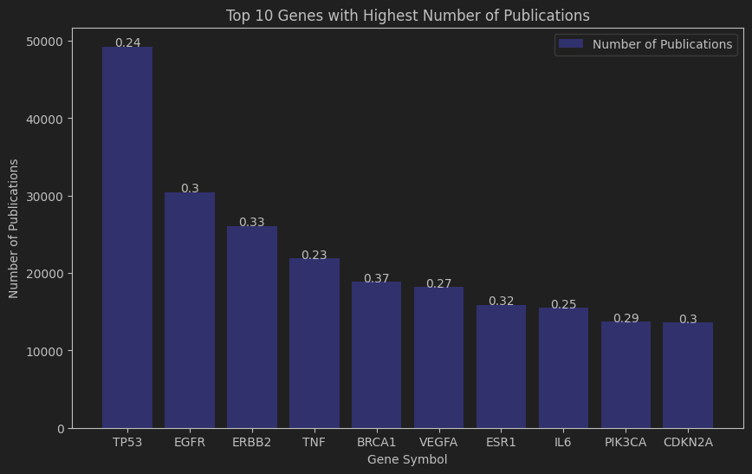
The Relationship Between Gene Publication Count, Disease Specificity, and Biological Processes
Raghu Ram Sattanapalle
Gene Symbol | Biological Process (GO Term)
TP53 | Negative regulation of transcription by RNA polymerase II, Mitophagy, In utero embryonic development
EGFR | MAPK cascade, Cell morphogenesis, Ossification
ERBB2 | Positive regulation of protein phosphorylation
TNF | Negative regulation of transcription by RNA polymerase II
BRCA1 | Protein polyubiquitination, Double-strand break repair
VEGFA | Negative regulation of transcription by RNA polymerase II
ESR1 | Negative regulation of transcription by RNA polymerase II
IL6 | Neutrophil apoptotic process, Germinal center formation
PIK3CA | Angiogenesis, Liver development, Vasculature development
CDKN2A | Regulation of cyclin-dependent protein serine/threonine kinase activity
Genes with more publications aren't necessarily more disease-specific.
TP53 tops the publication list but is not the most disease-specific.
BRCA1, with fewer publications than TP53, shows a higher DSI, suggesting a more disease-specific role.
The number of publications and DSI are valuable indicators of a gene's significance in disease processes, highlighting the importance of studying a gene's disease-specific role.
Notes:
Introduction This research initiative sought to answer the question: "Which genes have the highest number of publications (num_pubs)? Are these genes also the ones with high Disease Specificity Index (DSI)? And what biological processes (GO terms) are these genes involved in?"
Methodology In the data exploration process, we grouped the data by gene and calculated the mean DSI, providing an overall sense of the specificity of each gene across all diseases associated with it. This averaging helped interpret the “average specificity” of a gene to diseases, indicating whether the gene tends to be more specific or more general in its disease associations.
Findings Our findings suggest that genes with the highest number of publications are not necessarily the ones with the highest Disease Specificity Index. Genes associated with many diseases and hence having a low DSI tend to be studied more broadly and appear in more publications. On the other hand, genes associated with fewer diseases and thus having a high DSI might be studied in a more focused manner and, hence, feature in fewer publications.
Looking at the top 10 genes, we observed that TP53, a known crucial regulator of the cell cycle and tumor suppressor, tops the list of publication count. However, it is not the most disease-specific, with a DSI of 0.236 indicating a relatively broad role across several diseases.
Interestingly, BRCA1, often linked to breast and ovarian cancer when mutated, had a higher DSI of 0.367, suggesting a more disease-specific role, despite fewer publications than TP53.
Biological Processes By referring to the GO (Gene Ontology) terms, we inferred the biological processes these genes are involved in. For instance, TP53 is involved in the negative regulation of transcription by RNA polymerase. EGFR participates in the MAPK cascade, cell morphogenesis, and ossification, among other processes.
Conclusion While there's no direct correlation between the number of publications and disease specificity (DSI), both are crucial indicators of a gene's role and significance in disease processes. Moreover, GO terms provide valuable insights into the biological roles of these genes. Future studies could further explore this intriguing interplay between gene study prominence and disease specificity, possibly revealing untapped research areas.

